Slide 1

SAP BTP ABAP on Cloud / RAP
Training
DAY-9
Anubhav Oberoy
www.AnubhavTrainings.com
Follow excellence with sheer passion

Slide 2


DISCLAIMER
The training content and delivery of this presentation is confidential, and cannot be recorded, or copied and distributed to any third party, without the written consent of Anubhav Trainings

Slide 3

01
Behaviour Pool
02
Early Numbering
03
Feature Control
04
Actions
Notes:
https://pixabay.com/photos/san-francisco-transamerica-pyramid-1633203/

Slide 4

Development Flow – Processor and Approver
Fiori App – Processor
Create, update, delete, copy travel
Fiori App – Approver
Display the travel request data
Service definition
Service Binding
Service definition
Service Binding
MDE for Processor Projection
MDE for approver Projection
BDEF Projection
For Processor
Expose what is needed by a processor role in company
Behavior Definition (BDEF)
Tell RAP framework regarding our operations which needs to be supported for BO (managed)
BDEF Projection
For Approver
Expose what is needed by a approver role in company
Business Object Projection
For Processor
30 fields to internet
Business Object (definition)
Includes the Travel, Booking and Booking Supplement CDS entities
100 fields
Business Object Projection
For Approver
25 fields
www.anubhavtrainings.com

Slide 5

Behavior Pool
The transaction behavior of a BO in the context of RAP is implemented in one or more than one global class.
These special classes are dedicated only to implementing the business object behavior and called as behavior pool.
You can assign any number of behavior pool to behavior definition (a 1:n relationship)
Within a single global class, we can define multiple local classes that can handle the business object behavior.
The global class is just like a container and basically empty while the actual behavior logic is written inside the class pool.
We can assign any number of behavior pool to behavior definition (1:n). This allows us to distribute our implementation across multiple units. This is called contribution design pattern. Which allow team to work in parallel on multiple tasks.
A behavior implementation class always inherits from cl_abap_behavior_handler class.
Travel
(root)
Behavior pool
Helper classes
Booking
Behavior pool
Booking Suppl
Behavior pool
www.anubhavtrainings.com

Slide 6
Implicit Response Parameters
When implementing a BO contract, we can make use of implicit parameters. These parameters do not have FIX data type, instead they are assigned by the compiler with the type derived from BDEF.
The implicit parameters can be declared explicitly as CHANGING parameters in the method signature of the class using generic type
DATA: lt_imp_param FOR <OPERATION> entity.
Data : lt_mapped FOR CREATE BO-Travel.
FAILED
This is an exporting parameter which is defined as nested table contains one table for each entity. The failed table includes the information for identifying the data set where the error occurred. It has %CID, the ID of the BO instance, %FAIL which has the reason of failure. If_abap_behv=>t_failinfo
REPORTED –
This is an exporting parameter which is defined as nested table contains one table for each entity.it includes the instance specific messages.
%CID, ID of the relevant BO, %MSG with the message interface, %ELEMENT
MAPPED – Only during Create/Update operation
This is an exporting parameter which is defined as nested table contains one table for each entity. The mapped parameter provide the consumer with ID mapping information. They include information about key values were created by the application for given content id. The BO runtime passes the created key values in any subsequent call in the sample request.
%CID and %KEY
www.anubhavtrainings.com

Slide 7
BO instance features
Early numbering
It allows a managed numbering for bo instances during creation process. Like in ABAP we use sequence numbers (SNRO) to auto generate primary keys, here in RAP we can use early numbering. It can be handled for all the entities. For this we need to implement the logic in RAP BIMP.
Every assigned key must be unique, otherwise the instances will be rejected by the database which will result to dump. We will be reusing a SNRO sequence already created by SAP in the system.
www.anubhavtrainings.com

Slide 8
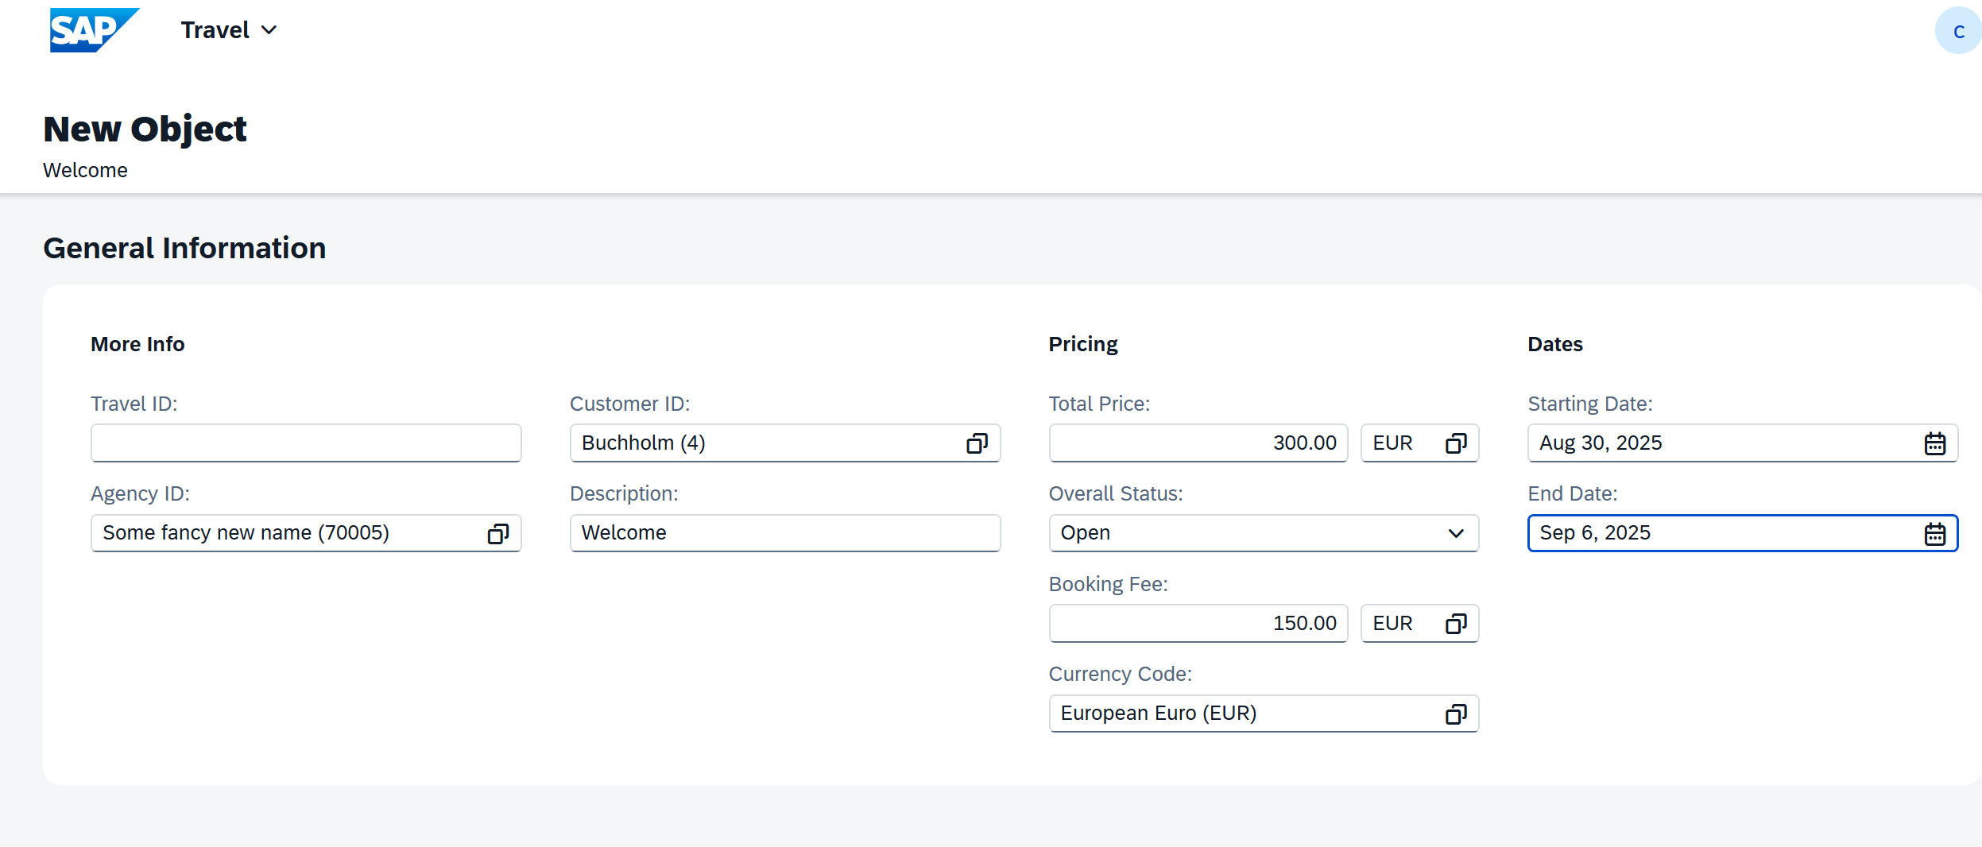






Sequence of calls
Fiori app
OData
RAP
BIMP
HANADB
Entities (1 rec, 18fields)
FAILED, MAPPED, REPORTED
www.anubhavtrainings.com

Slide 9




























Slide 10
Exercise
Assign the booking Supplement ID automatically during creation with early numbering.
www.anubhavtrainings.com

Slide 11
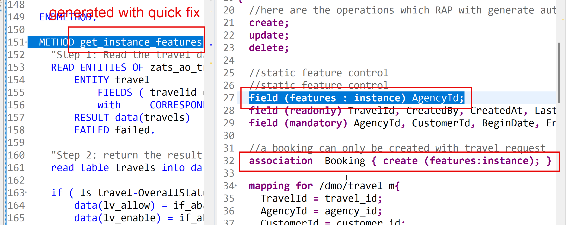
Feature Control
As an application developer we want to determine which entities of our BO needs to allow create-, update-, delete- operations. Apart from that which properties of BO are allowed to be mandatory, read only, creatable, updatable. We can also control the availability of our data actions.
In RAP, feature controls are of 2 types:
Static feature control – are specified at the level of behavior definition only. Statically declared and easy to implement.
Dynamic feature control – complex to implement for more complex requirements. They require a mandatory implementation in BIMP class. We use keyword features:instance
www.anubhavtrainings.com

Slide 12
www.anubhavtrainings.com
Thank You
End of Day 7
www.anubhavtrainings.com

Slide 13


We’re committed to empower you to be
#FutureReady
through powerful training solutions.
We build the workforce of the future.
250+
Corporate Clients
30,000+
Learners Trained
25000+
Learners Placed
FREE WEBINARS
Sign up for free webinars with industry experts every fortnight!
Enroll Now!
Contact us today!
https://anubhavtrainings.com

